Slide 1
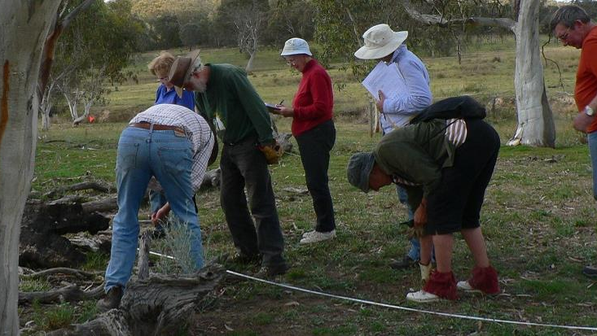
Vegwatch Monitoring Program
Practice and findings 2011 to 2018
Report to the Molonglo Catchment Group
Supported by the ACT Environment NRM program and
Capital Region Landkeepers

Slide 2
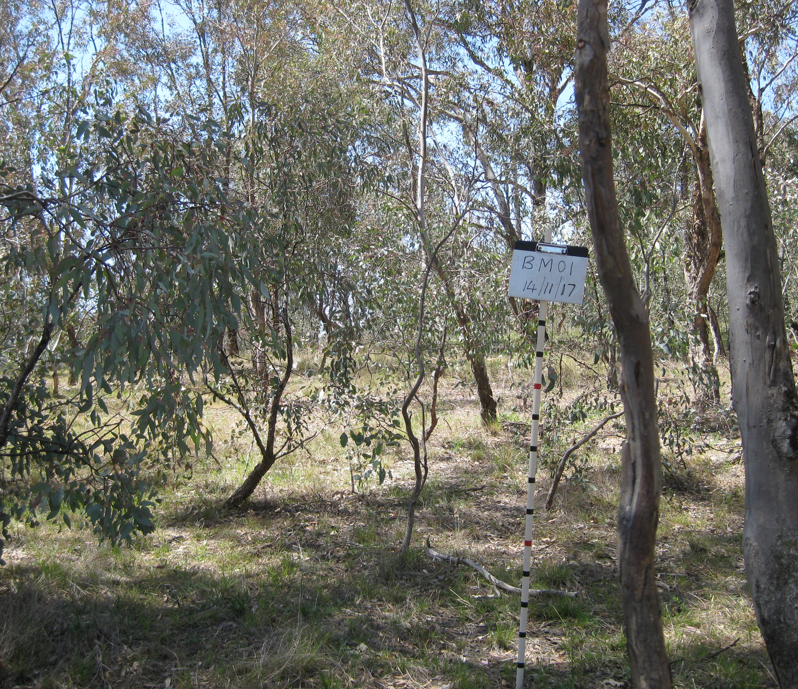
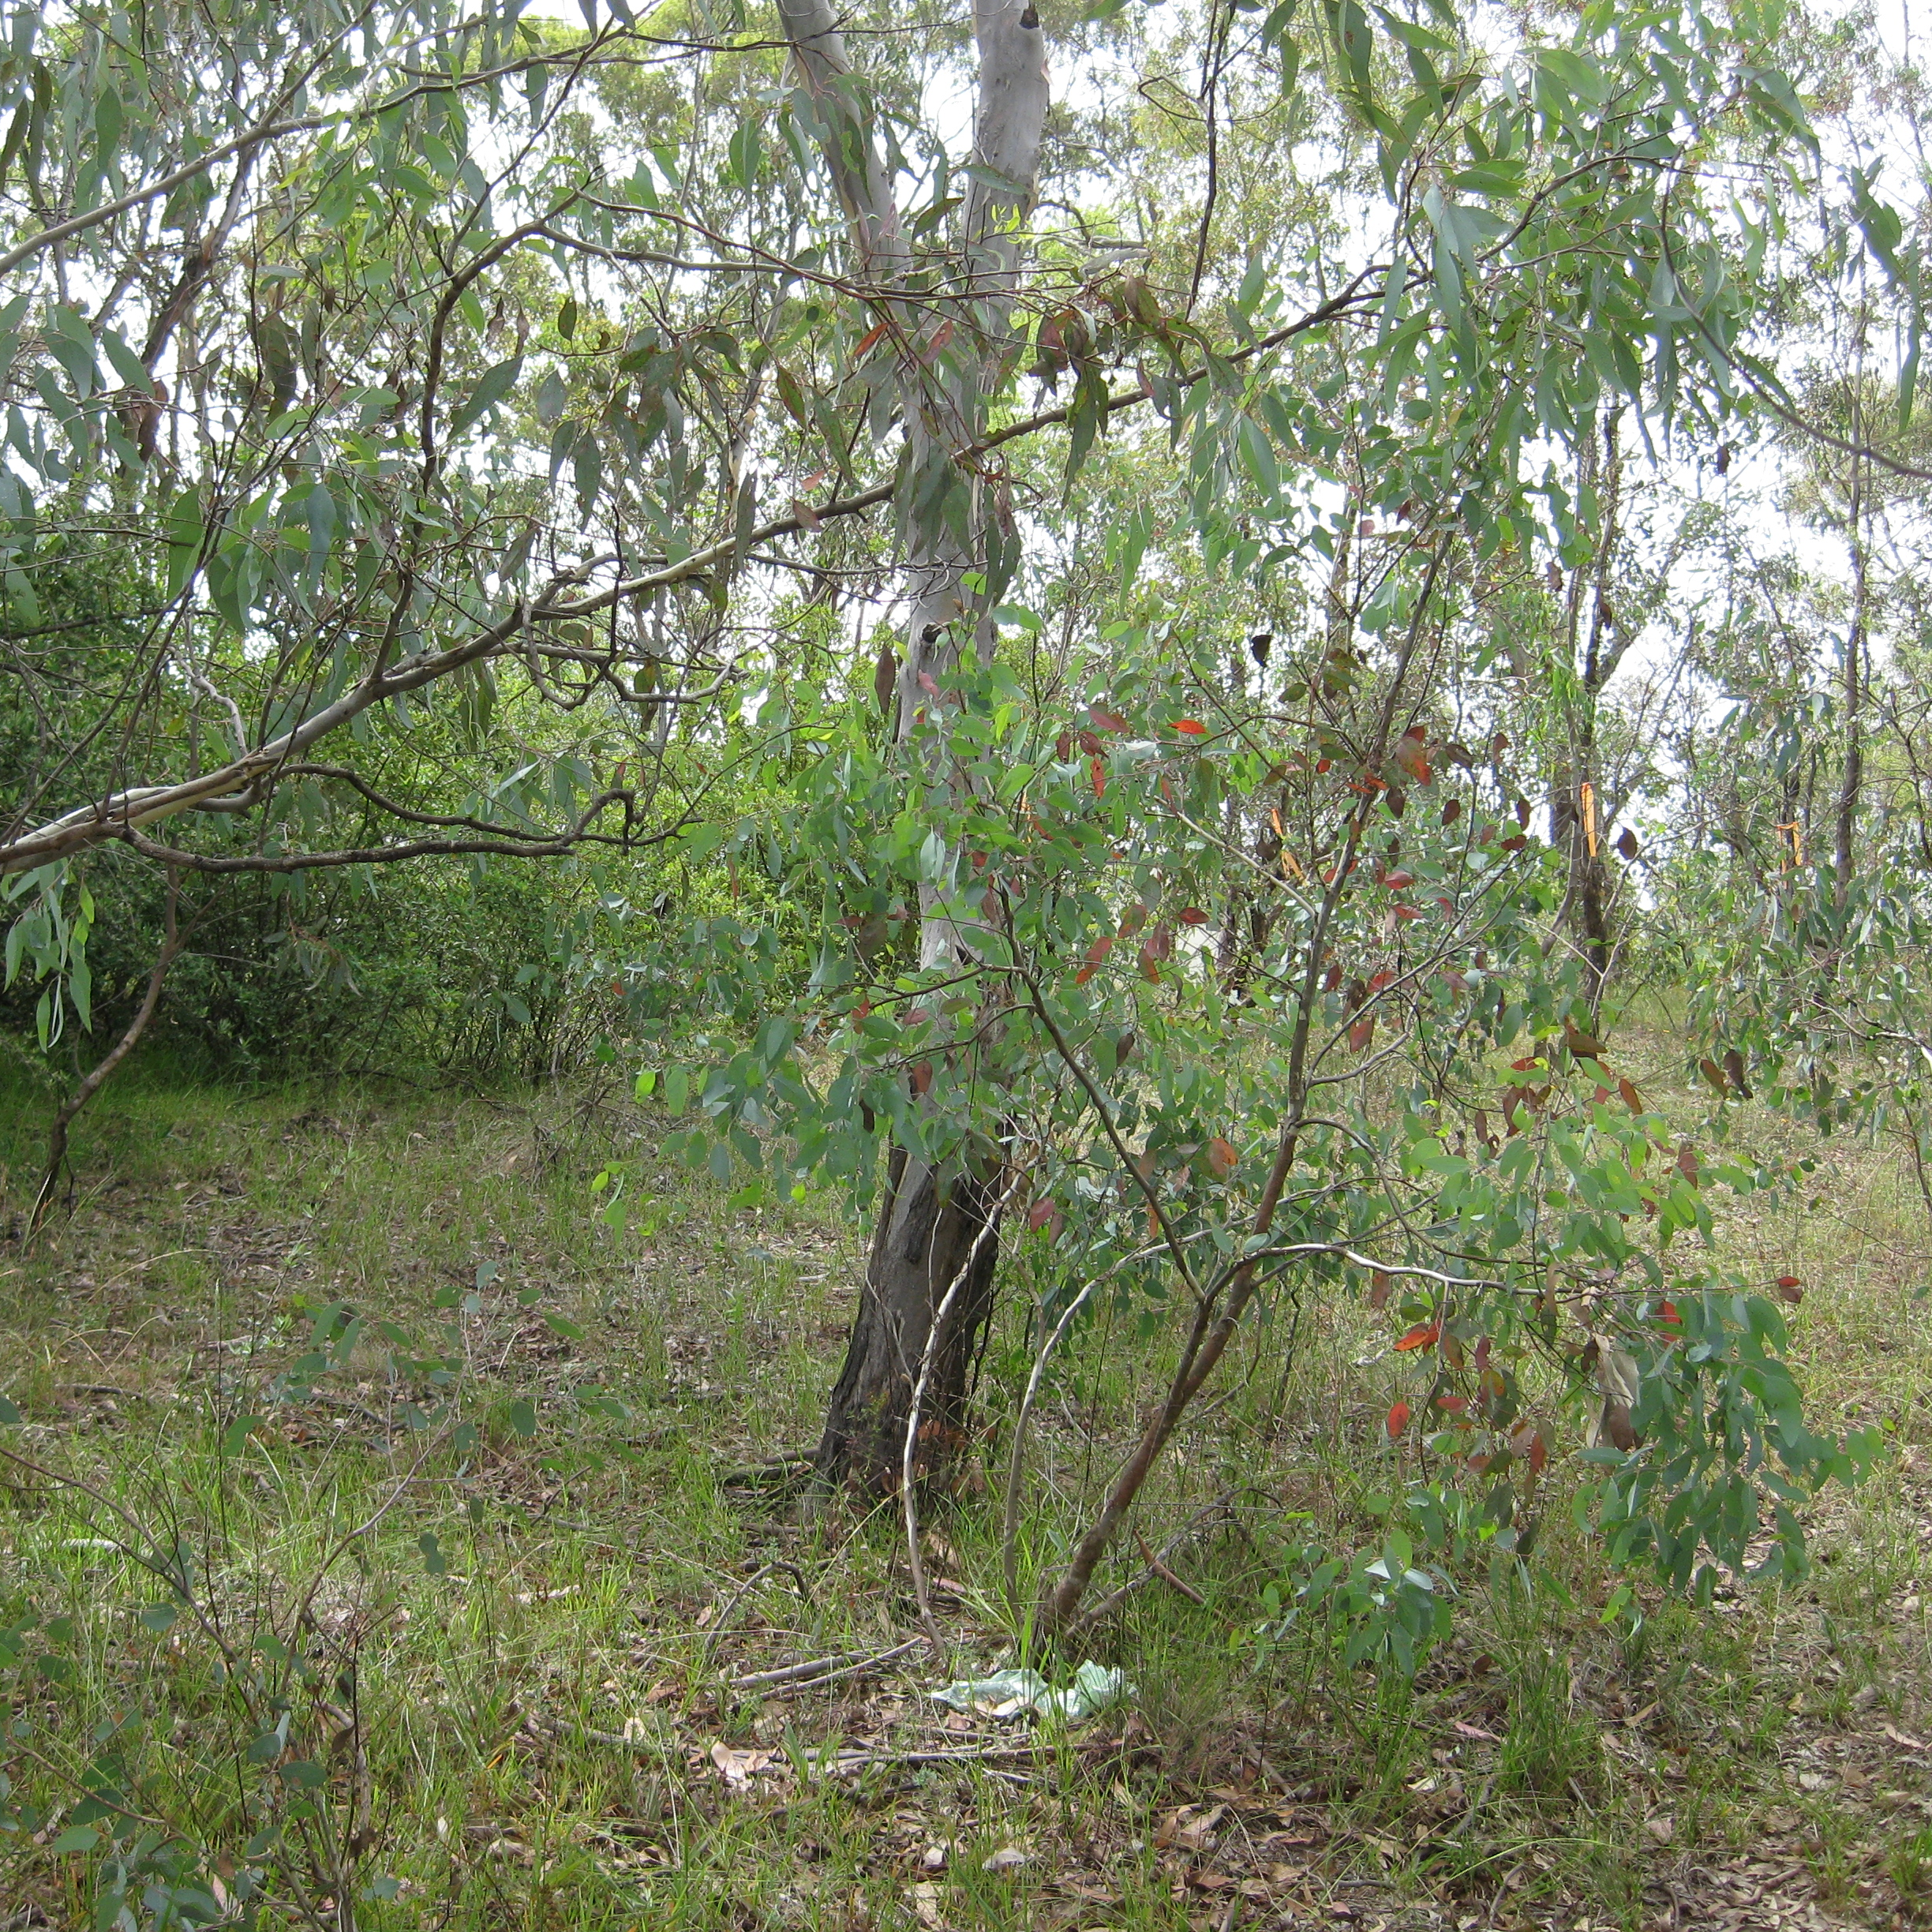
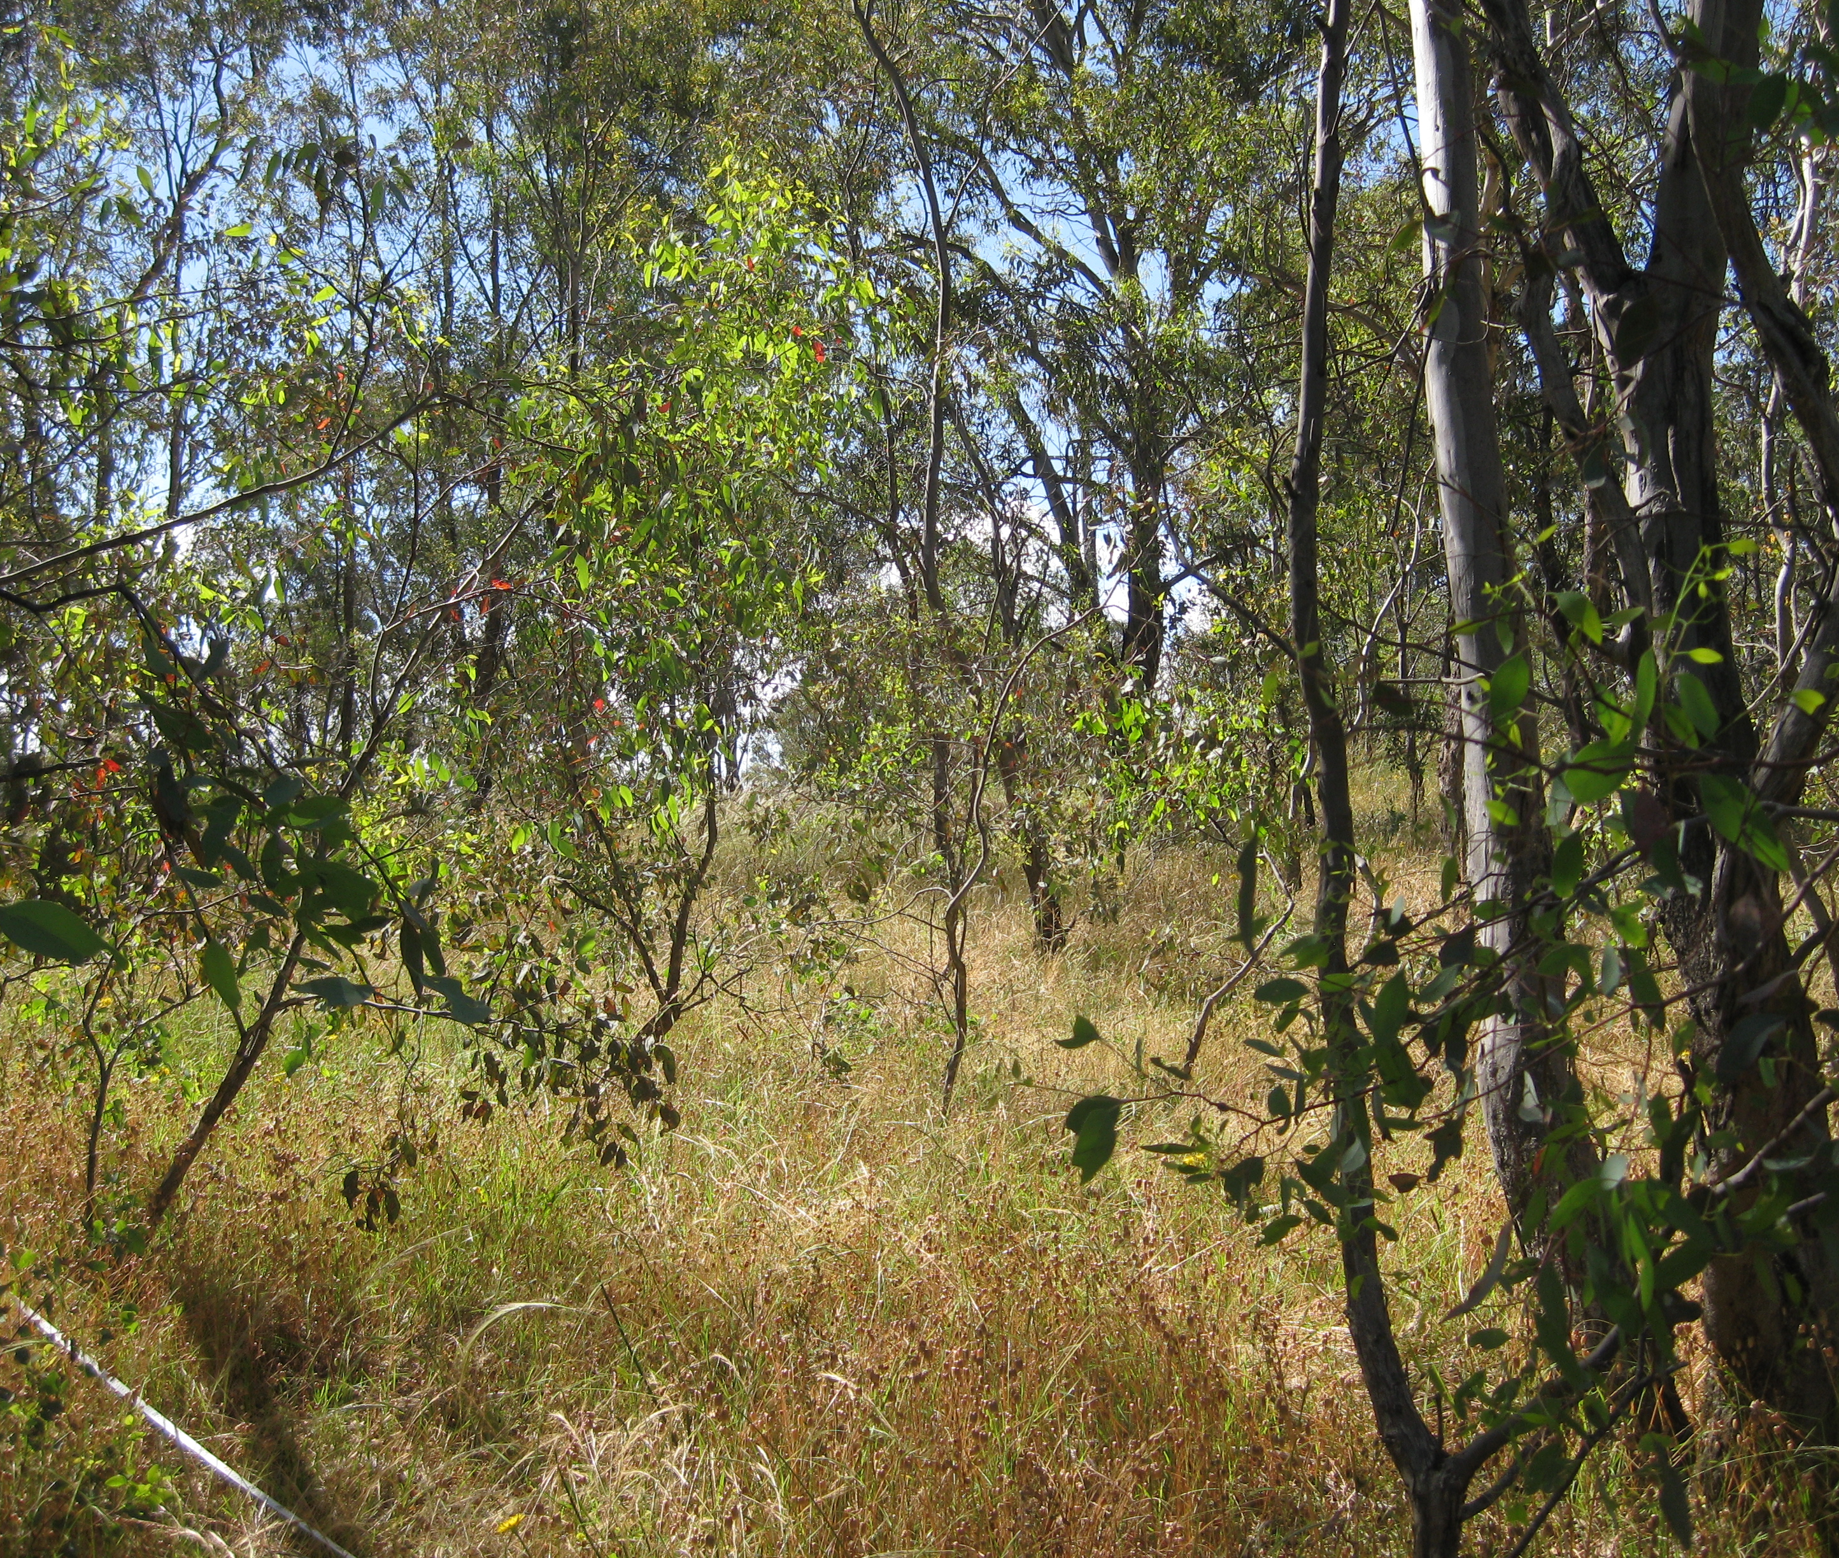
The role of monitoring
Implementation of adaptive management.
Monitoring measures changes over time of condition.
Linked with research to justify remedial actions.
Citizen science programs are integral.
Plan
Act
Monitor and research
Review
Modify
Notes:
The site is Bullan Mura in Yarralumla: 1. before woody weed control, 2. and 3. after woody weed control, demonstrating the changes in structure and cover of the mid- and groundlayer.

Slide 3
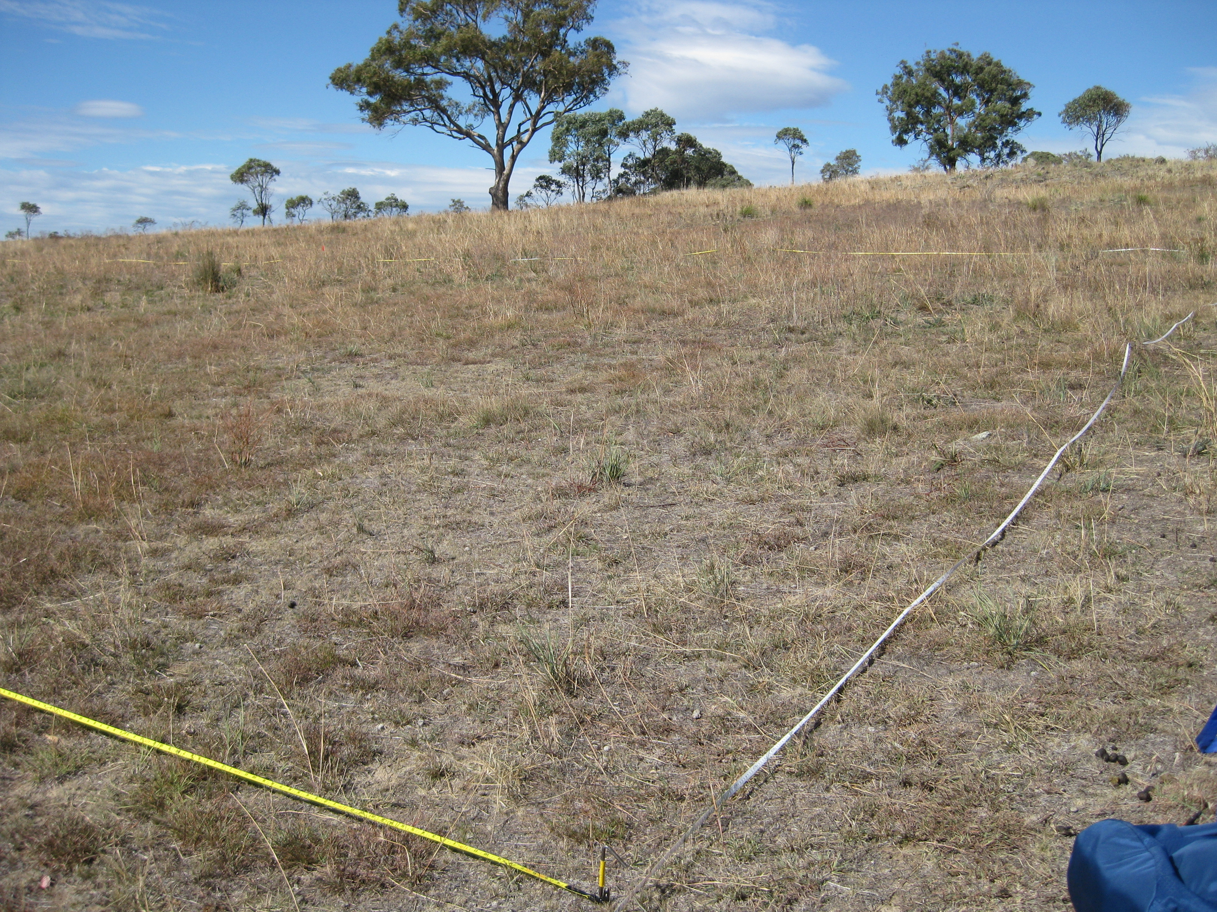
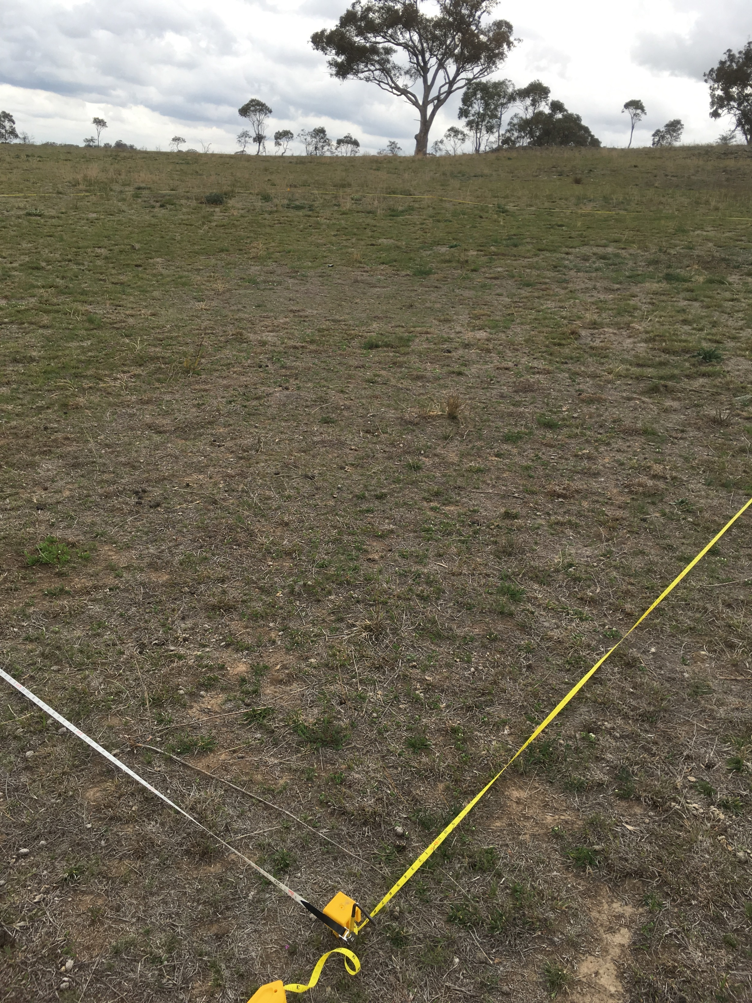
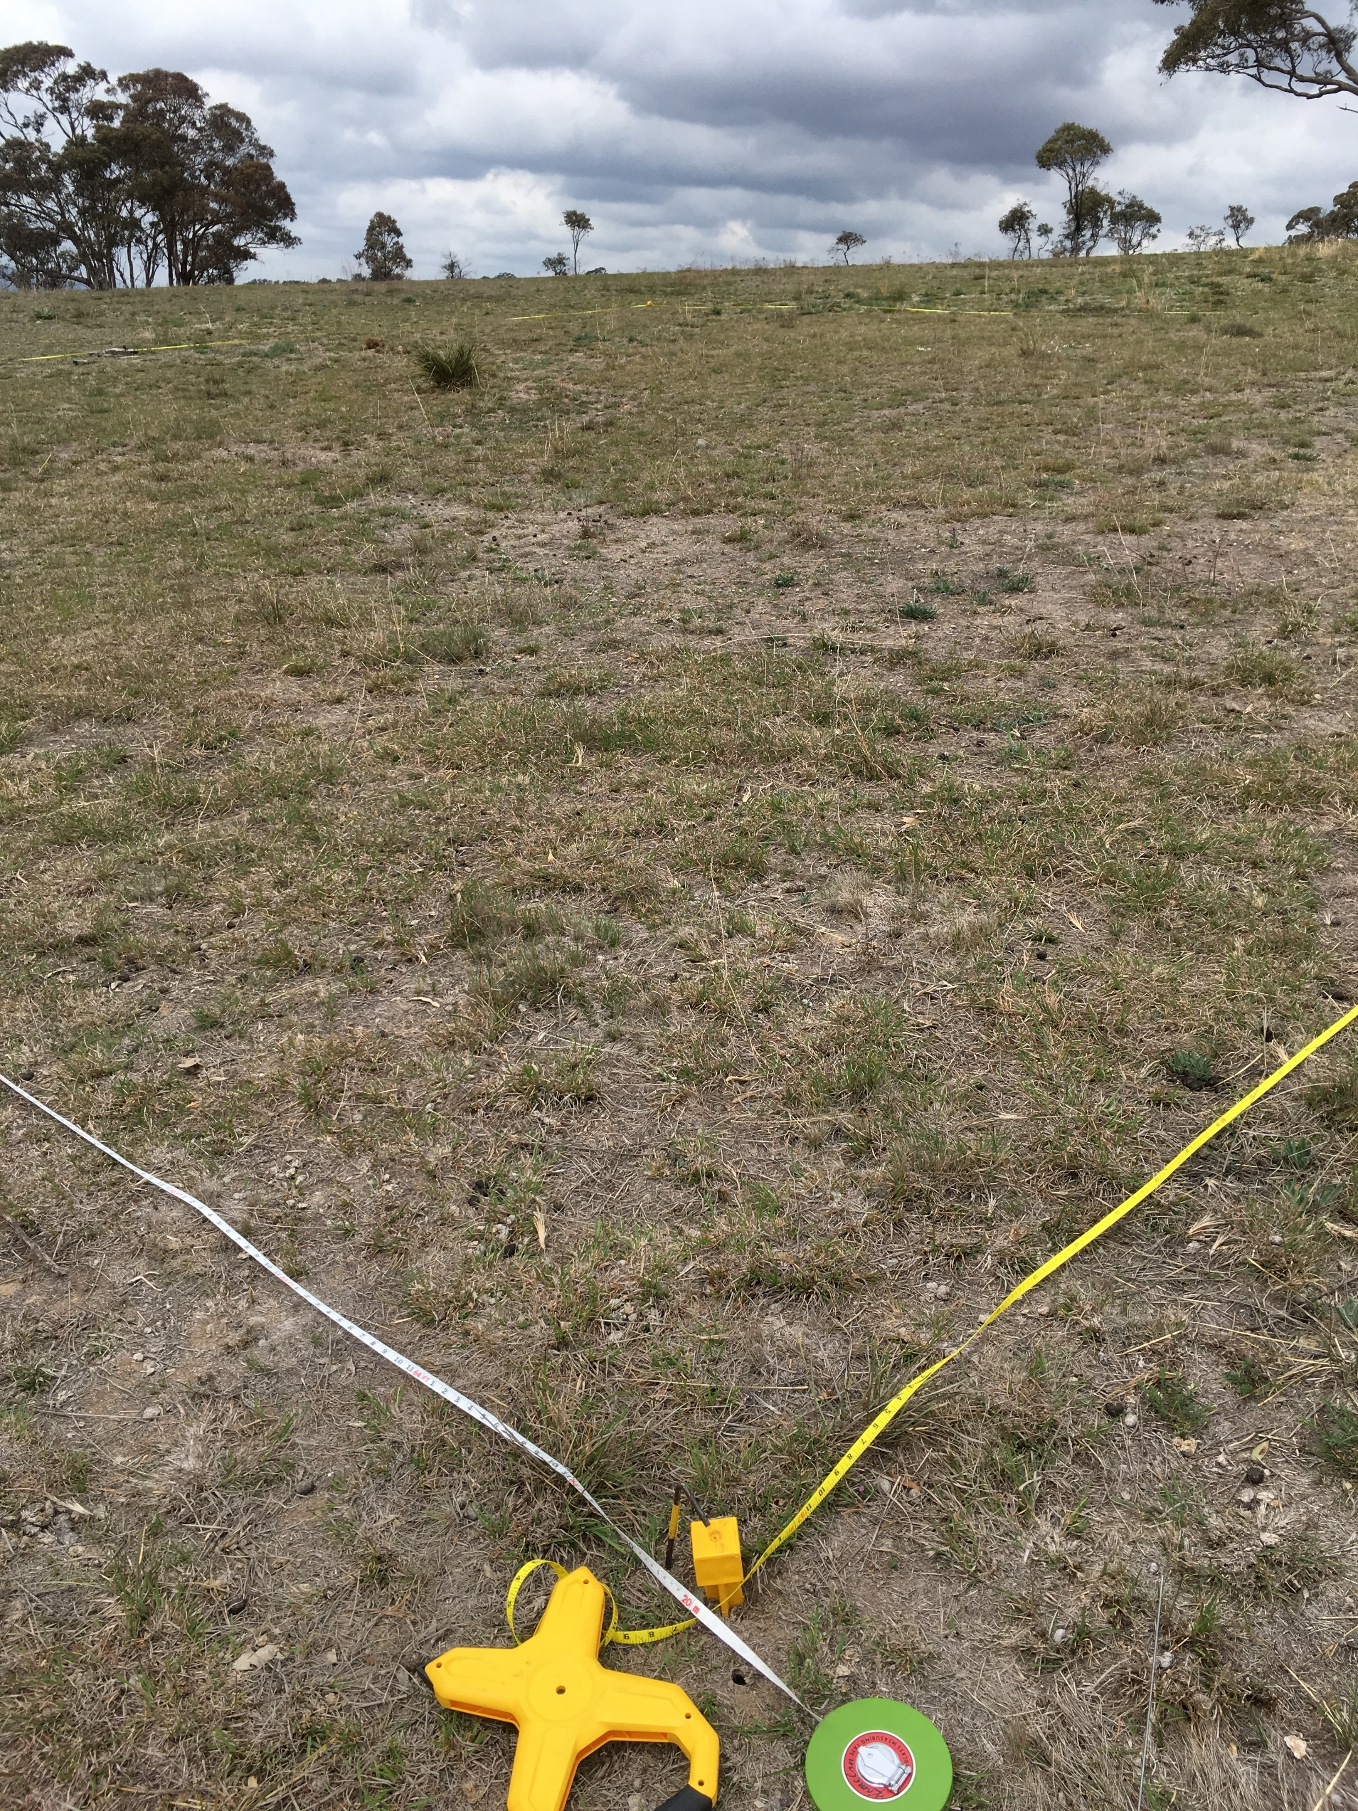
The Vegwatch monitoring program
Wandiyali, pre-burn
A citizen science monitoring program to measure change in condition of vegetation and habitat.
Is management achieving desired outcomes in my site?
Link in with other programs to provide data for more complex analyses.
Is management achieving desired outcomes across the landscape?
Post-burn, higher diversity than the adjacent unburnt plot
Notes:
Monitoring enables observations of change to be backed up by quantitative measures.
For example, is the spraying of St John’s Wort effective – is it dying, is it recovering, what other species are responding?
The quantitative information be used to
notice and report on issues
share and learn
Reporting
Justification for further management and/or support
Important that the reasons for monitoring are identified – ie to see if the intended outcomes have been achieved.

Slide 4
Vegwatch implementation 2011 to 2018
Plot
50 m
Data are collected in a plot and along transects.
The data are used to calculate indices of condition.
20 m
Transect
Quantitative data collected:
Species richness and abundance
Species cover
Structural diversity
Habitat diversity
+ Photomonitoring
+ Observations of condition and management applied
Notes:
Since 2011, 33 plots have been established in 21 sites in the ACT region (three others were established but discontinued; data from these plots were not included in the review).
Annual surveys have been undertaken between once and seven times.
Methods are based on data collected in a plot and along transects.
Data collected are quantitative.
The data were used to calculate indices of condition.
Data are entered into a database for storing and reporting on the data (supported in part by a grant from ACT Environment).
Facilitation and coordination of the program has relied since 2013 on volunteer assistance.

Slide 5
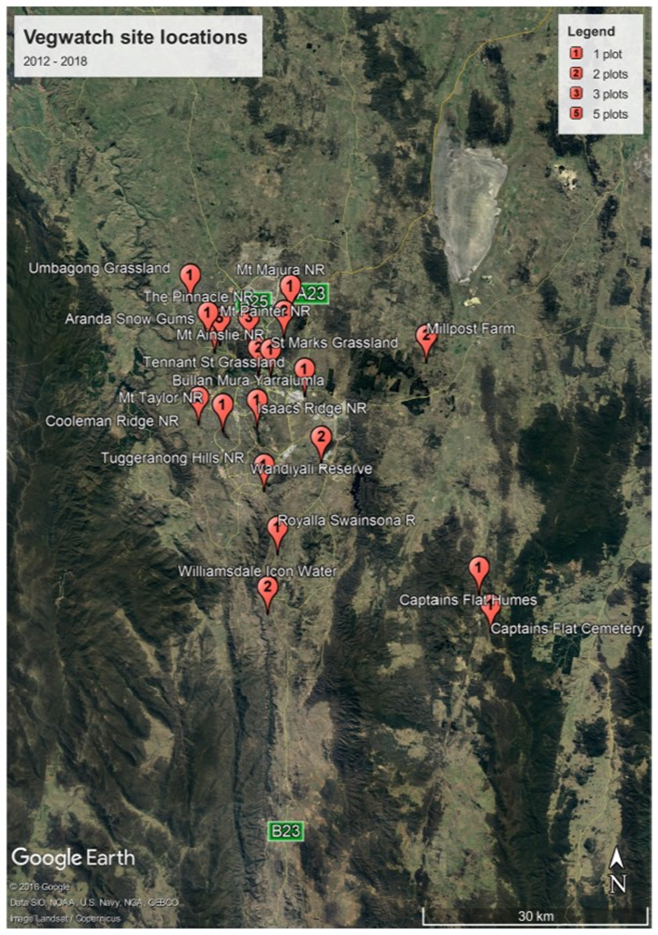
Characteristics of the plots
Since 2011, 33 plots have been established in 21 sites in the ACT region.
15 groups have been involved.
Management applied includes burning, woody weed control, herbaceous weed control and revegetation.
All but one are managed for conservation.
Notes:
Since 2011, 33 plots have been established in 21 sites in the ACT region.
15 groups have been involved
24 plots in 15 sites were established in ACT.
9 plots in 6 sites were established in NSW.
31 plots are managed for conservation outcomes.
2 plots are managed for primary production (one of which has a conservation ethic).

Slide 6
Vegetation structure
Vegetation association | Vegetation structure | Vegwatch plots (sites)
Natural Temperate Grassland | Grassland | 5 (4)
Derived grasslands (Yellow Box – Red Gum woodland) |  | 4 (3)
Other derived native grassland |  | 4 (4)
Yellow Box- Blakely’s Red Gum +/- White Box tall grassy woodland | Grassy woodland | 8 (6)
Snow Gum mid-high grassy woodland |  | 1 (1)
Mealy Bundy – Broad-leaved Peppermint shrubby mid-high open forest | Shrubby woodland | 2 (2)
Brittle Gum-Scribbly Gum shrubby tall dry open forest |  | 2 (1)
Environmental native plantings |  | 3 (2)
Red Stringybark – Scribbly Gum – Red-anthered Wallaby Grass tall grass-shrub dry sclerophyll open forest | Forest | 3 (1)
Snow Gum – Candlebark tall grassy woodland in frost hollows and gullies |  | 1 (1)
Notes:
Most plots are within the critically endangered communities:
Natural Temperate Grassland – 5 plots in 4 locations
Yellow Box – Red Gum Grassy Woodland: 12 plots in 9 locations.
Other plots in other native grassland, shrubby woodland and forest.

Slide 7
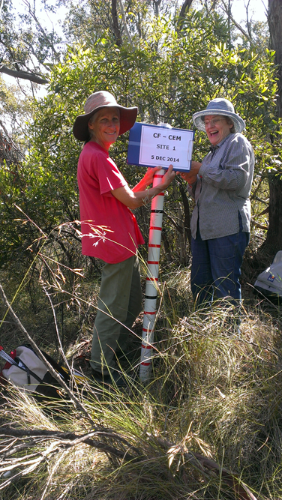
The review of the Vegwatch program
The review was implemented to provide feedback to the participants and others,
To identify information to guide adaptive management,
Provide the data to incorporate into metadata sets and
Identify how Vegwatch can be effectively utilised in the future to guide adaptive management.
Notes:
The review was implemented to provide feedback to the participants and others, and acknowledging that if Vegwatch is to continue it requires on-going support which would only be available if it is deemed to provide useful information to guide adaptive management.
The review had four elements:
To test the accuracy and usefulness of the data and identify the best indicators of change in condition.
To describe the change in condition at the plot level and across the plots, based on the best indices of change, relating it to management applied.
To identify whether the participants found their involvement in the program valuable.
To consider any changes that should be made to the program to ensure it retains scientific robustness and is useful both to participating groups and for combination with other data to enable metadata analysis.

Slide 8
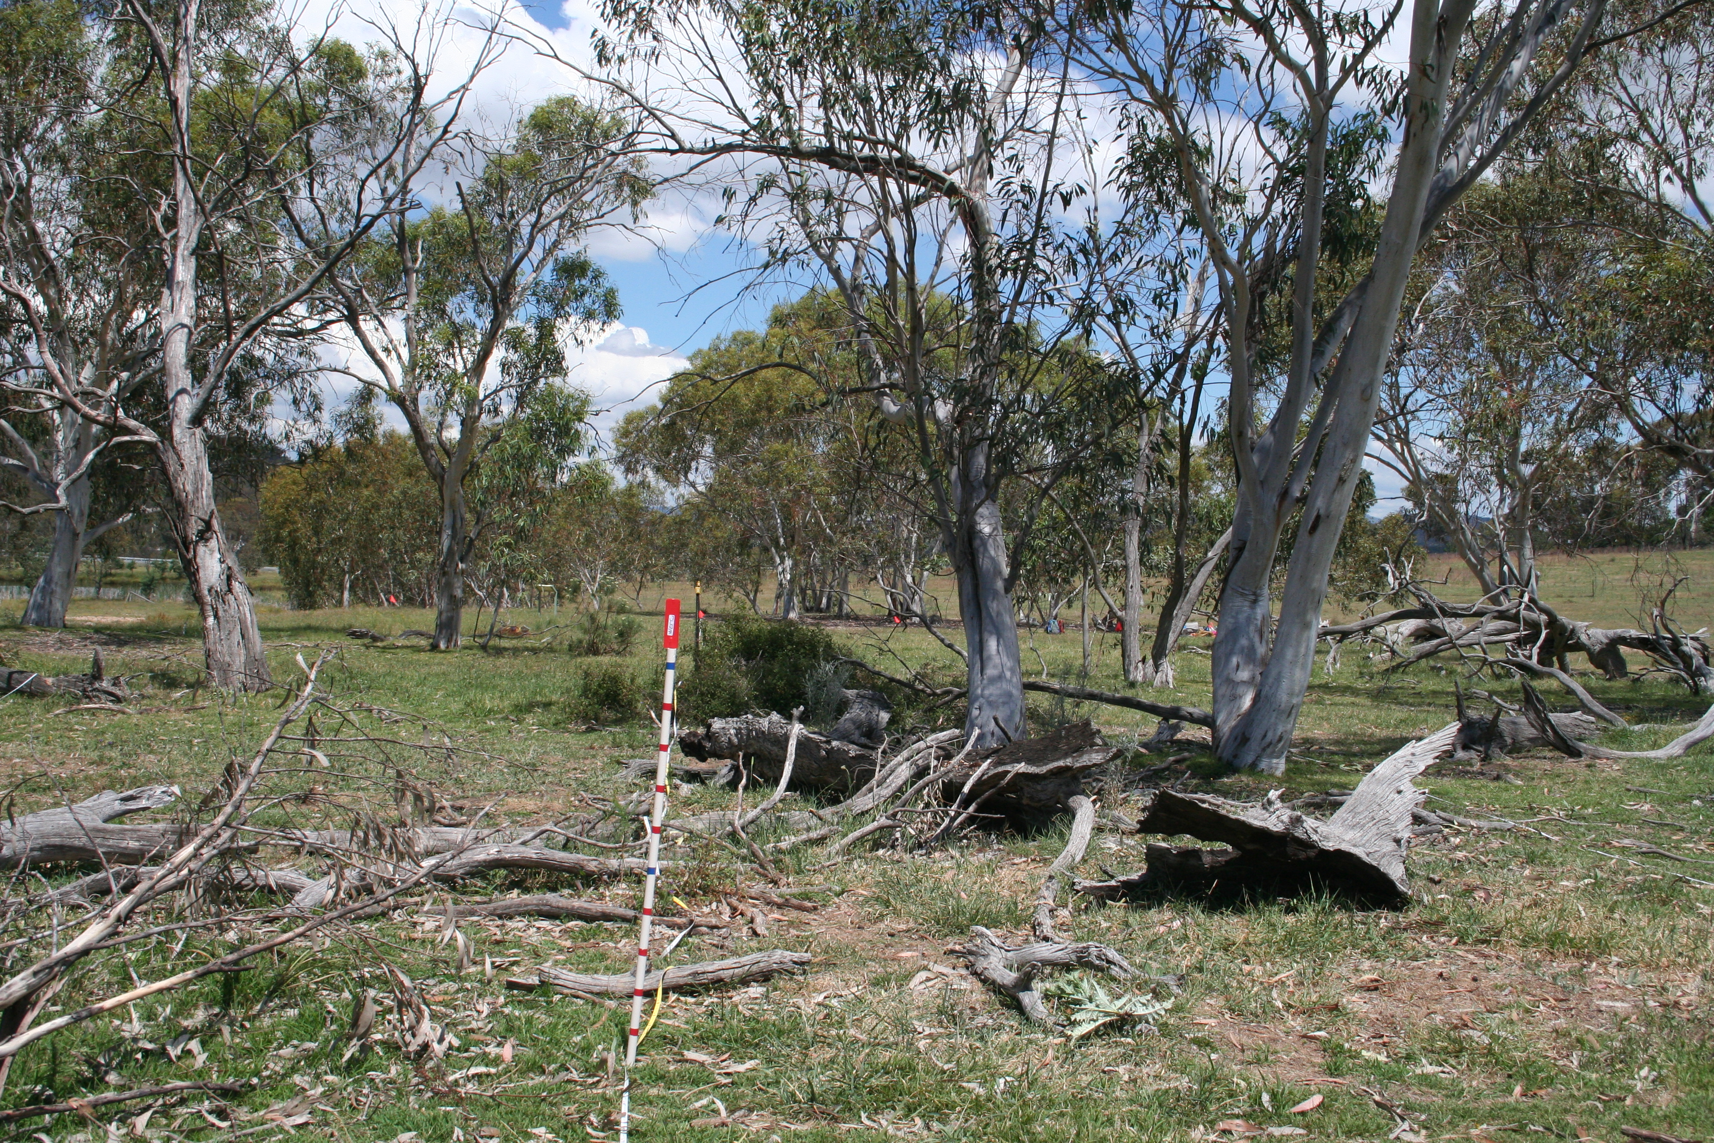
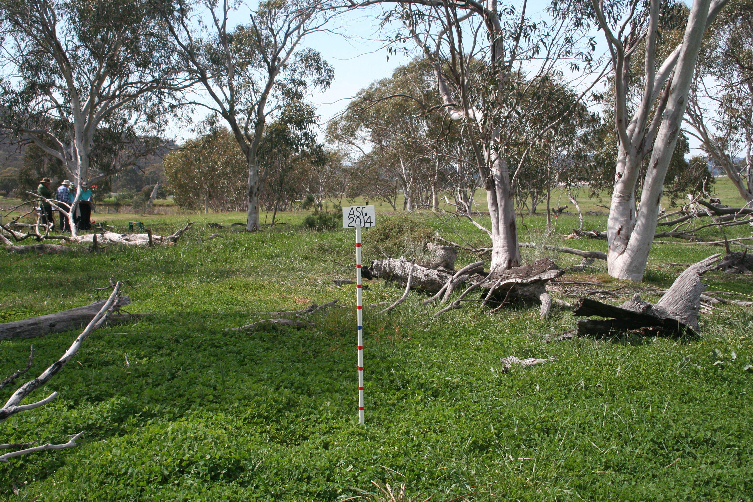
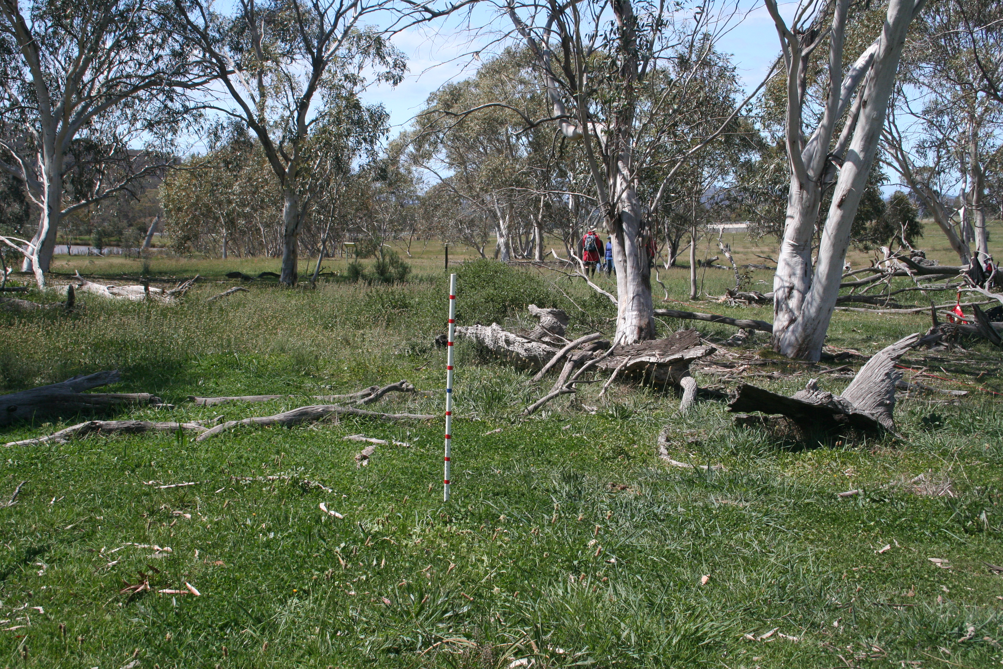
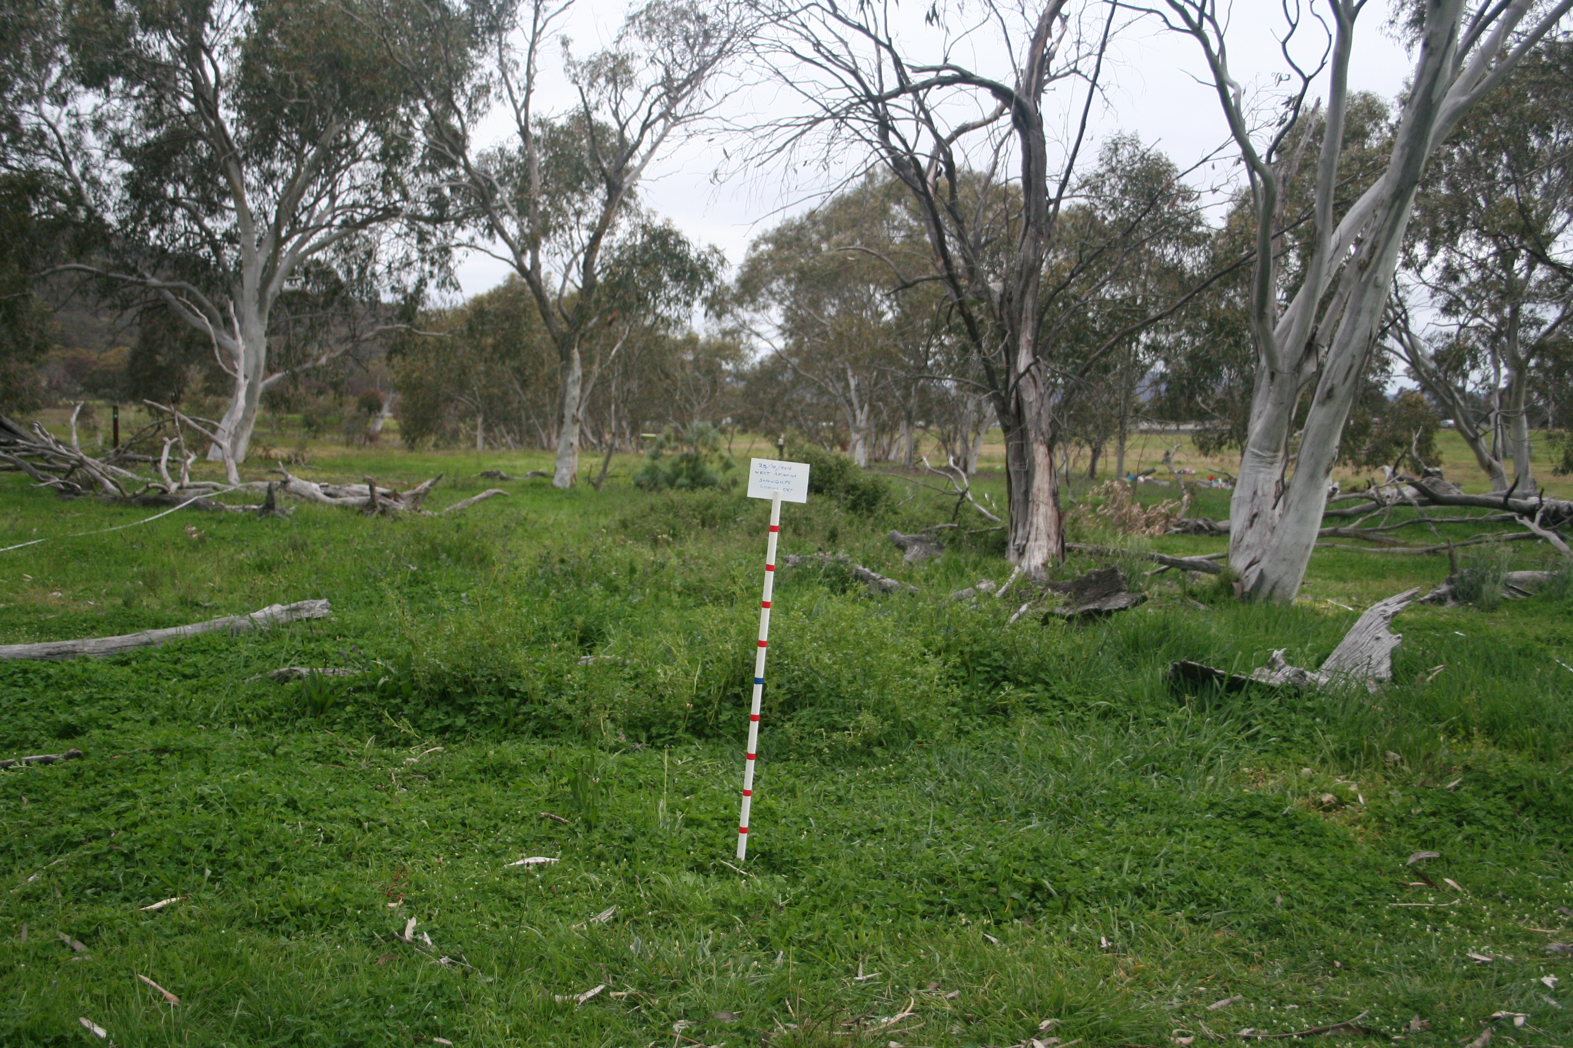
Identification of drivers that could compromise the data
Were the methods robust?
2. Were the data collected by citizen scientists robust and comparable to those collected by ecologists?
3. Were data significantly influenced by seasonal condition?
2013
2014
2015
2016
Notes:
Were the methods robust?
The methods used are the same as are used in other similar surveys and monitoring and training provided to users.
The data gained are the same and accepted by the scientific community as robust.
2. Were the data collected by citizen scientists robust and comparable to those collected by ecologists?
The data grouped by experience indicated no significant differences in the data collected by Vegwatch participants and ACT Government ecologists.
Therefore it was deemed that the Vegwatch data were accurate and comparable to data from other monitoring programs.
3. Were data significantly influenced by seasonal condition?
A quantitative measure of root zone soil moisture for each year was calculated using data from the Bureau of Meteorology to identify variability in seasonal growth conditions.
There was no overriding differentiation of the data related to soil moisture availability.
This allowed the data to be analysed to identify the condition of the plots and the key factors related to condition.

Slide 9
Factors related to the identified changes in condition
Primary drivers | Secondary drivers (applied actions) | Ecosystem stressors
Vegetation structure Past land uses and disturbance Seasonal variation | Biomass manipulation Revegetation | Invasive weeds Soil moisture availability
Notes:
Monitoring at this level (lack of plot replication in sites and lack of controlled treatments) enables identification of factors that correlate with change in condition within the sites but correlation does not equate to causation.
Vegetation structure was a key factor in differentiating between plots.
This was not unexpected, but clarified the requirement to limit comparison of trends in condition across plots containing different vegetation structure.

Slide 10
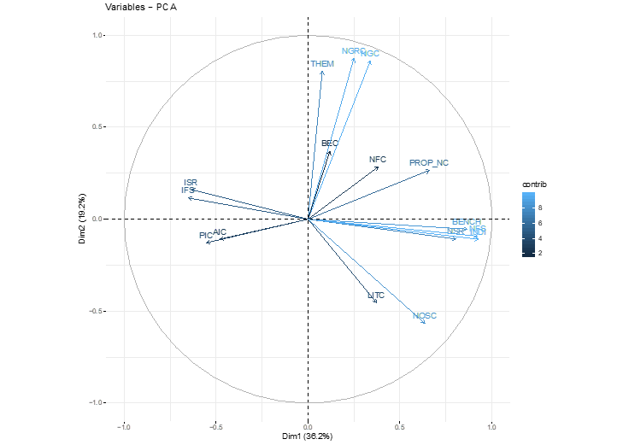
Indices that provided the most useful information about change in condition
Native cover
Introduced species richness
Native richness
Introduced species
Notes:
There was considerable overlap in the correlation scores of groups of indicators.
The indicators that were simplest to measure and calculate were:
Native plant species richness (presence/absence) also used to calculate indicator species richness
Introduced plant species richness also used to calculate invasive species richness
Groundcover attributes including native groundcover, bare ground cover, annual introduced cover, perennial introduced cover and proportion of perennial native groundcover.
Introduced species richness was not correlated with the level of native species richness
Therefore it is important to consider change in condition in terms of both native and introduced (perennial and annual) richness and cover.

Slide 11
2. Change in condition of the plots, 2011 to 2018
Notes:
A 95% confidence interval was calculated to differentiate between background variability attributable to the drivers and stressors, calculated for each vegetation structural formation.
Any change beyond the confidence intervals was deemed a change in condition caused by secondary drivers and/or ecosystem stressors.

Slide 12
Management | Improving | Stable or variable
Burnt plots | 3 + 2? | 2 + 5?
Woody weed control |  | 2
Herbaceous weed control | 1 | 2
Revegetation: herbaceous species |  | 2
Revegetation: woody species |  | 3
No management | 4 + 4?
Notes:
While the program was effective in identifying change in condition in the individual monitored locations, the lack of replication of plots subjected to a particular management intervention within sites has limited the ability to generalise about the impacts of management interventions within or across sites.
Burning and woody weed control: high levels of variation measured as changes in species composition and abundance that correlated with soil moisture availability occurred after biomass reduction.
After burns three plots met the criteria as critically endangered communities.
Revegetation: while changes in survival of tree and shrub revegetation did not relate to soil moisture availability, herbaceous revegetation success declined when soil moisture levels were low, demonstrating the difficulties of herbaceous species revegetation.
The data need to be combined with larger compatible datasets to gain more definitive information on the effects of management. More time is required to measure changes in condition following interventionist management.

Slide 13
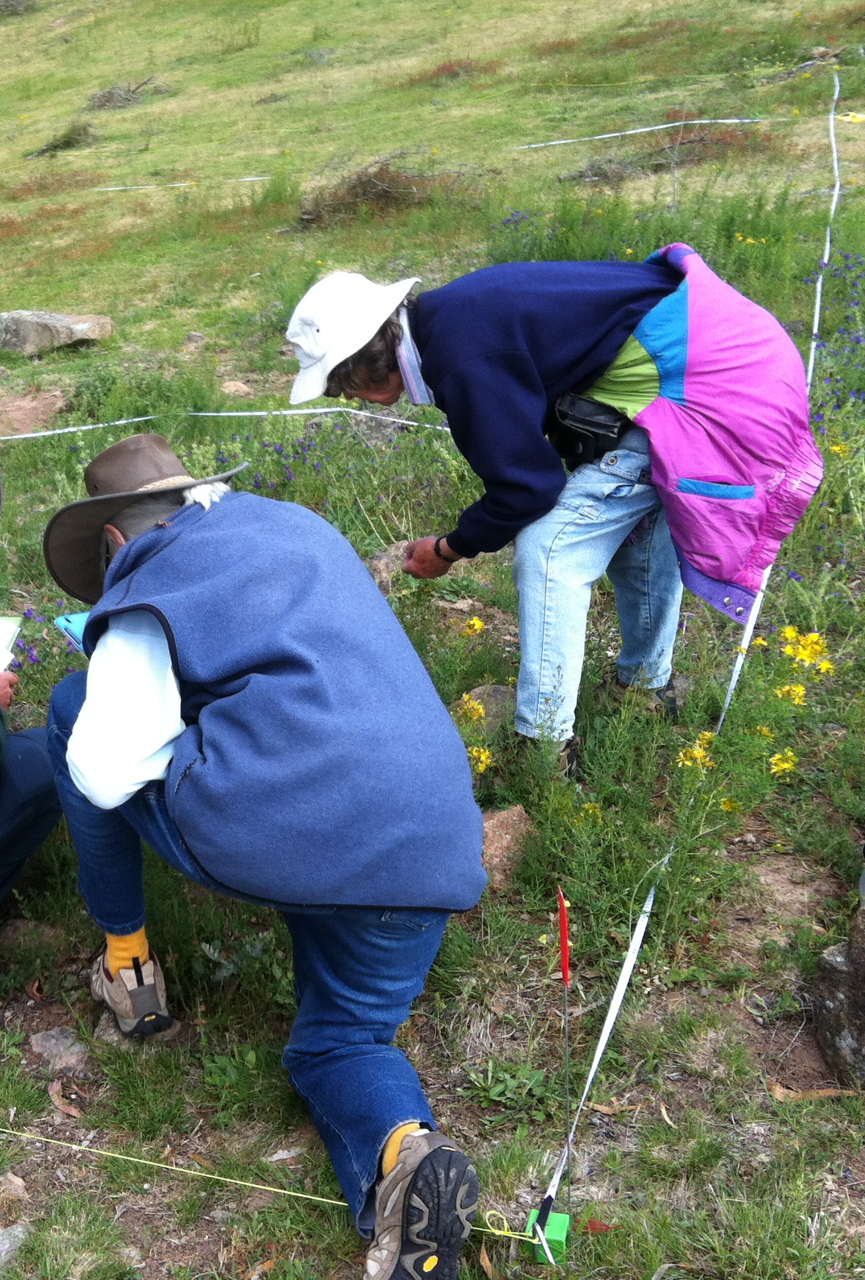
3. What value was the monitoring to the participants?
12 plots have been monitored five or more times
4 were only monitored once and then ceased
12 plots were only included from 2017
Those with good expertise in group or where expertise was provided were more likely to find it valuable.
Training and on-going support was vital to maintain interest and ensure data were collected consistently.
Notes:
Participants were asked to provide feedback on their experience of the monitoring.
Some data proved difficult for participants to record accurately; for example, some people found species identification and estimating abundance and cover challenging.
The lack of on-going support to participants has decreased motivation and compromised the quality of some data.
Lack of resources has limited opportunities to communicate the results to volunteers, community, government and other groups, to share the data with other organisations or otherwise promote the program.
However, in 24 plots monitoring has ceased:
4 were not continued after the first year and
8 groups have either indicated they wished to cease monitoring or have not monitored for the past 4 years.
Some groups have gained the information that they required for their purposes.
Some indicated they found it too difficult and/or not of personal value or enrichment.
Other reasons (not provided) may include time limitations, lack of support within their group or turnover of people within their group.

Slide 14
4. The future of Vegwatch
1. Changes to methodology
Simplified
Maintain consistency
More information collated on management applied
Information on disturbance to be provided to land managers
2. Implementation and continuity
Link with other programs: sharing data and resources
Feedback of information for reporting eg State of Environment
Funding: consistent project management is vital
Training and updating training
Notes:
The overlap of relationship between some condition indicators were used to revise methods, so that the data are as simple as possible to collect, while not losing integrity.
The data need to be consistent with those collected in other programs, particularly the ACT Government monitoring programs.
Some data collected at the initial and final surveys need to be undertaken by more skilled practitioners, other data can be collected by participants with less experience (but assisted as required).
Ideally there will be more replicate plots established in sites, especially as controls where significant management interventions are applied.
At the plot and site level the changes in condition indicators are useful to guide whether the condition is being maintained or improving at that location.
The data can be integrated with other data to provide more robust conclusive information to guide adaptive management.
The data provide insights into the dynamics of vegetation and the short, medium and long-term affects of applying biomass controls including burning, extensive weed control and revegetation.
Results can be used to guide future management and for reporting on outcomes, such as State of Environment Reports
Some existing groups will continue their existing monitoring program, or expand it across their sites, where their primary aim is to gain insight into change in condition at their sites.
Additional plots could be established and monitored by citizen scientists in locations to supplement those monitored in government programs.
Integration into the NRM grants program will to ensure comparative methods are used to measure quantitative change in condition where funding is applied to modify vegetation (e.g. revegetation, weed control).
This will facilitate Vegwatch data to be utilised more broadly and enable better comparison of results across the landscape.

Slide 15
Contacts and more information
Citation: Sharp S., Vegwatch Monitoring Program: practice and findings 2011 to 2018. Molonglo Catchment Group, Canberra
For more information on the Vegwatch program: sarahsharp@molonglo.org.au
For copies of the report: https://molonglo.org.au (Molonglo Conservation Group)
Acknowledgements:
Many thanks to the volunteers who have undertaken the monitoring and waited patiently for feedback on the results.
Fellow ecologists and statisticians have provided invaluable advice in development of the program and in the preparation of the review of the program.
Three grants from ACT Government and one from the Capital Region Landkeepers have supported elements of the program implementation.

