Slide 1
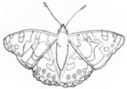
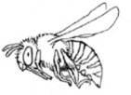
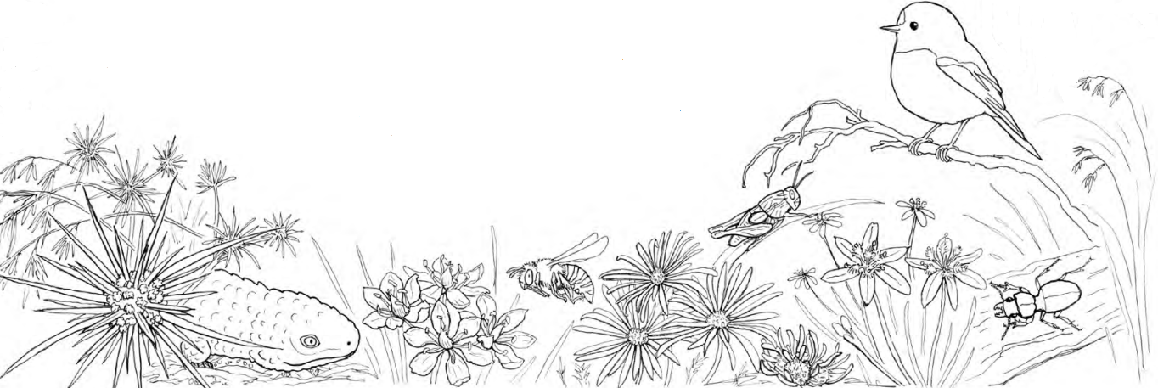

Wondrous Box-Gum Grassy Woodlands
Woodland Listening Sounds

Slide 2
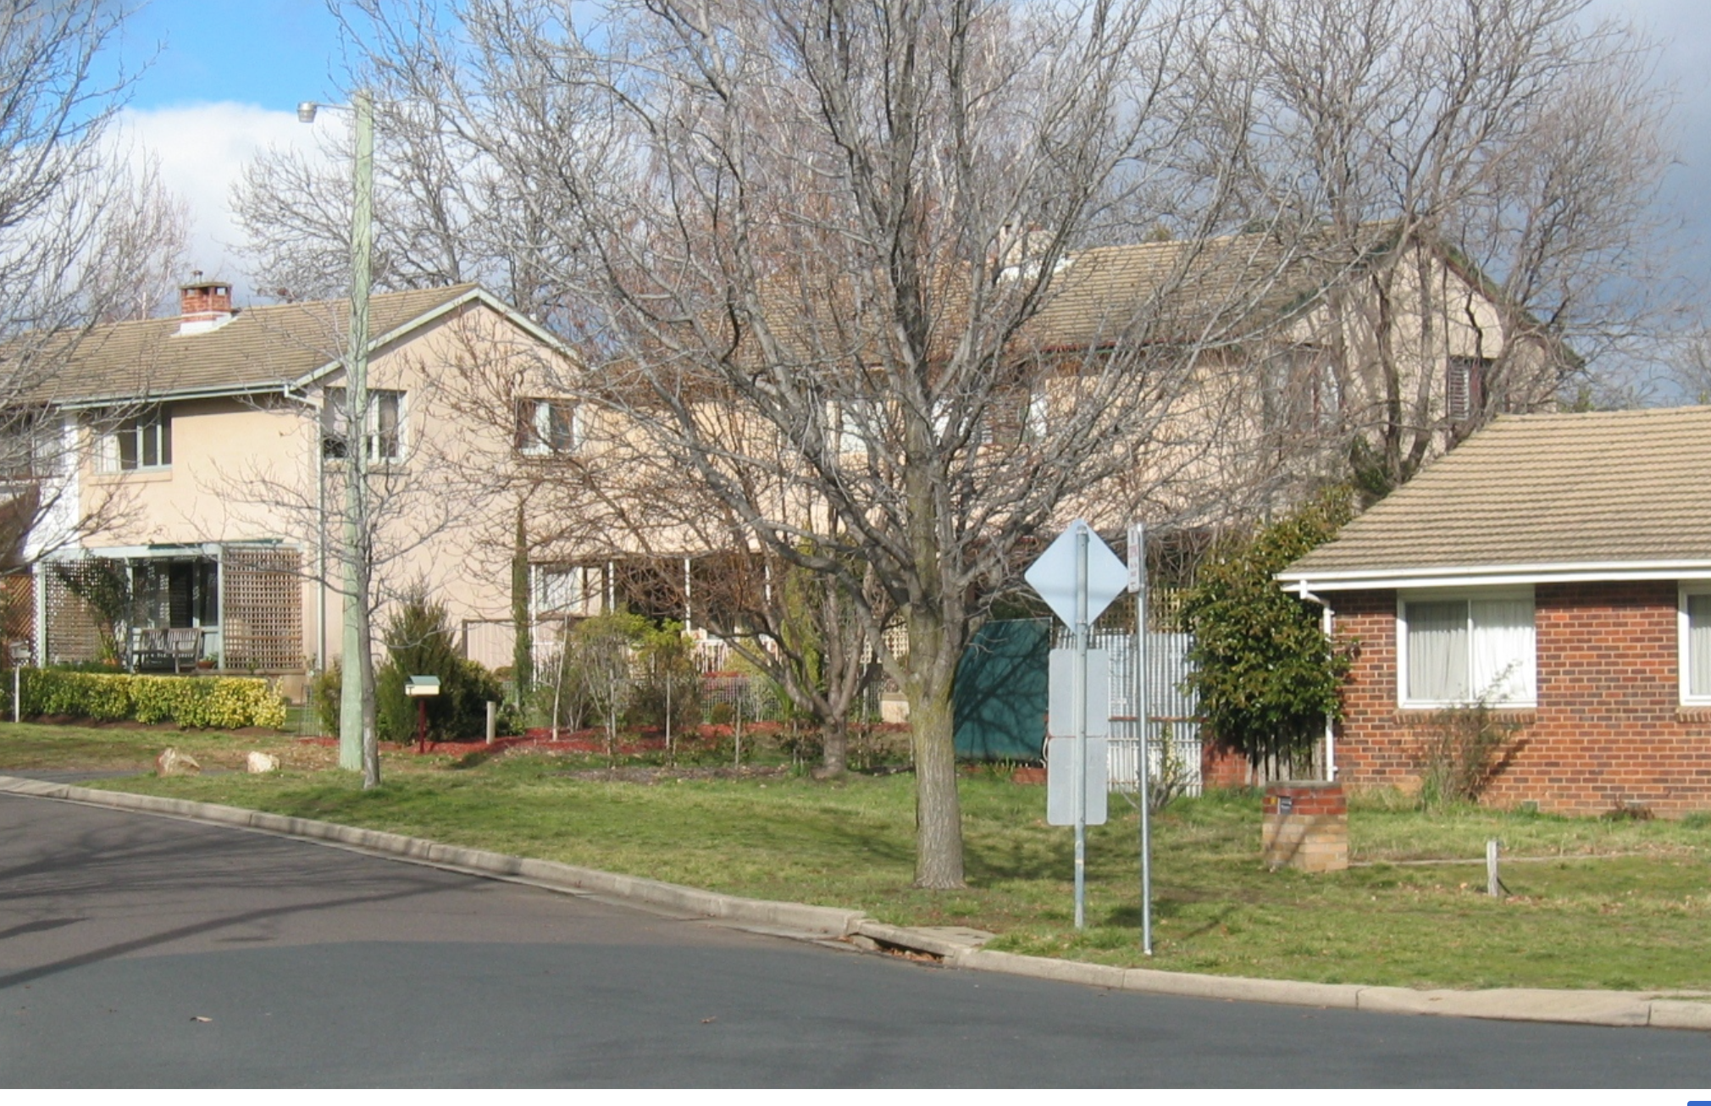
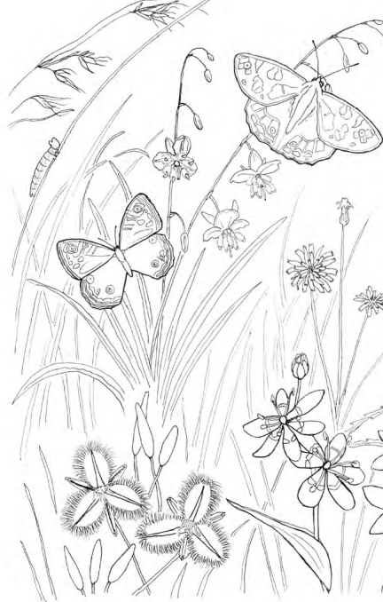

Close your eyes, listen carefully
What animals can you hear? What animals do you hear that live around your house?

Slide 3
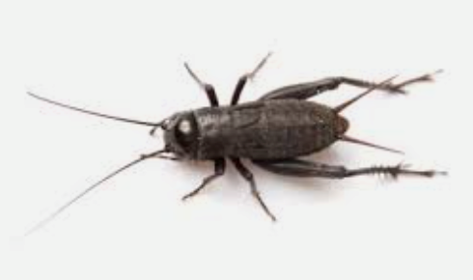
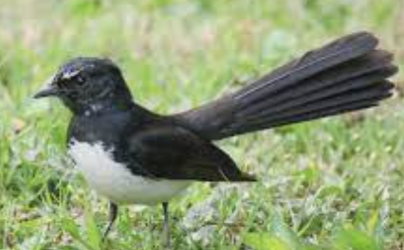
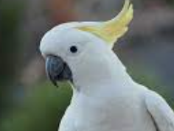
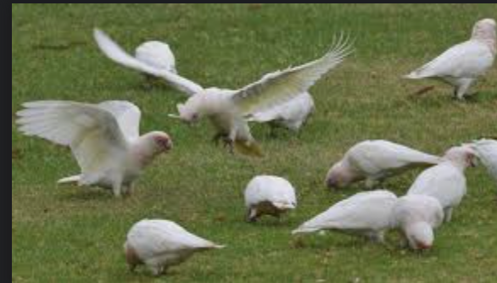
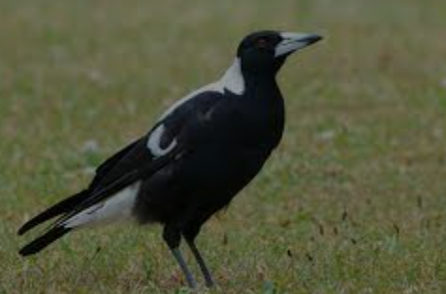
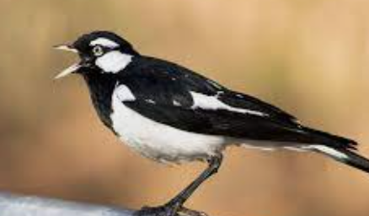
Did you hear any of these? What other birds and animals do you hear at your house?

Slide 4
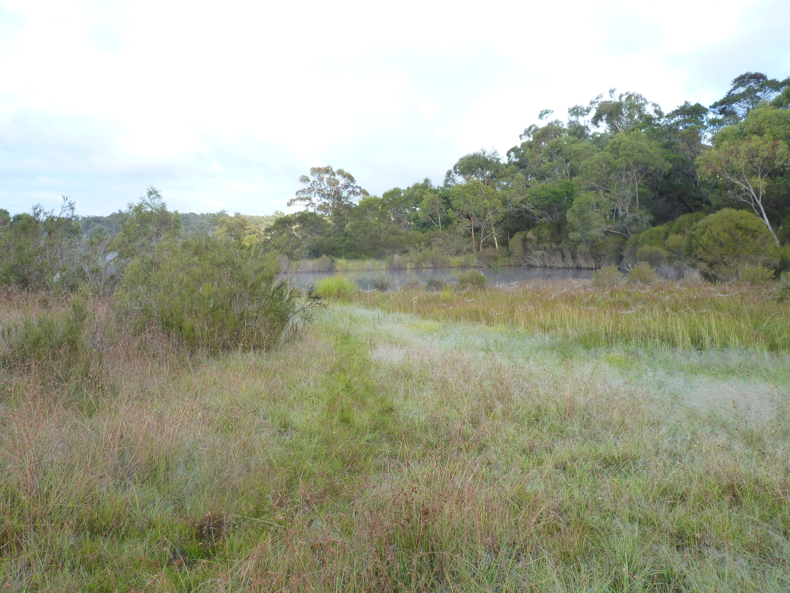
Close your eyes, listen carefully
What animals or kinds of animals can you hear that live here?

Slide 5
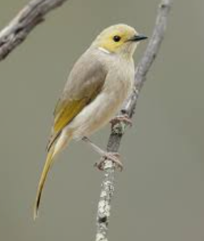
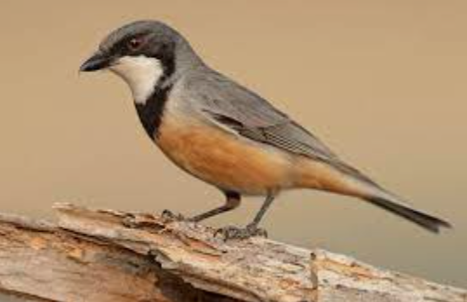
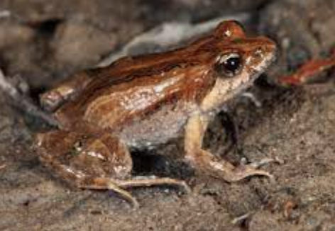
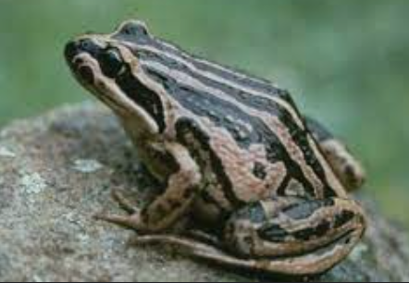
These are the animals you could hear.
All recorded and living not too far from your school.
Have you seen any of them before?
Magpie
Rufous Whistler
White-Plumed
Honeyeater
Common Eastern Froglet
Striped Marsh Frog

Slide 6
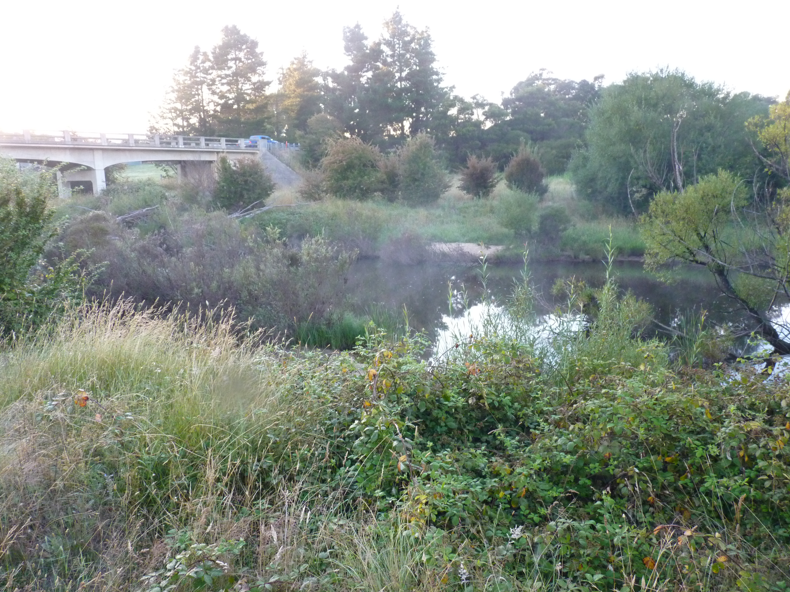
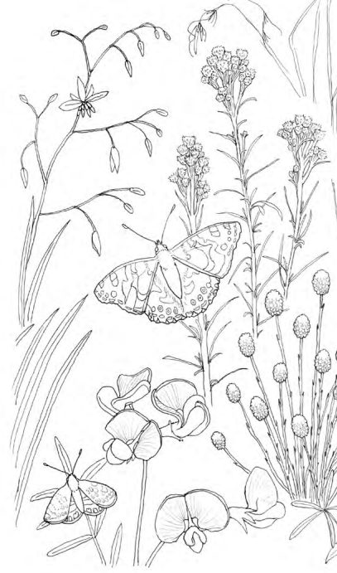
Close your eyes, listen carefully
What animals can you hear that live in this place?

Slide 7
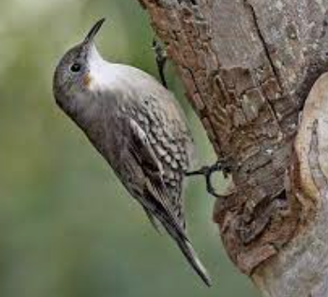
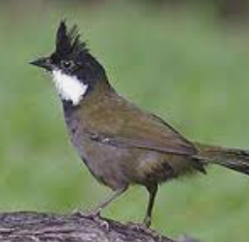
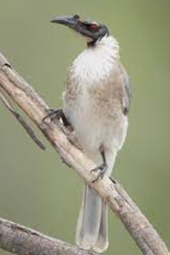
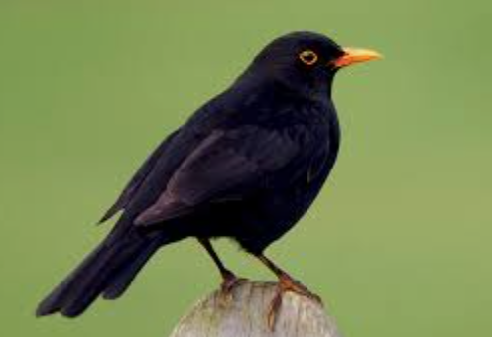
These are the birds you could hear. All recorded and living not too far from your school. Have you seen any of them before?
White-Throated Treecreeper
Rufous Whistler
Eastern Whipbird
Noisy
Friarbird
Common European
Blackbird

